Slide 1
ZooKill Soccer
A Game Design Document
Created by: Your Name

Slide 2
Game Design Document - 1
Animals are breaking out of their Zoo Cages!
Your job is to kick Trump like a soccer ball so that he collides with a Zoo Animal
If you successfully kick Trump into the path of an escaping Zoo Animal, it will “do what it will” to Trump and return to its cage
Otherwise, the Zoo Animal will come after YOU.

Slide 3
Game Design Document - 2
Sequence
At the start of the game, the cages open
Animals drift down the screen to attack you
You have a Trump which you can kick into their path
Each animal who collides with Trump is satisfied, and returns to its cage
An animal who makes it past Trump will attack YOU (game over)

Slide 4
The Characters
You (your foot, since your kicking Trump like he was a soccer ball)
The Animals (4 of them, in cages at the top of the screen)
Trump (next to your foot at the start so you can kick him but possibly could exit the screen if you don’t keep kicking him into the upper region of the screen

Slide 5
Game Design Document - 3
You WIN the game by returning all animals to their cages, while Trump is still functional
You LOSE the game if Trump becomes non-functional, or a Zoo Animal manages to grab YOU

Slide 6
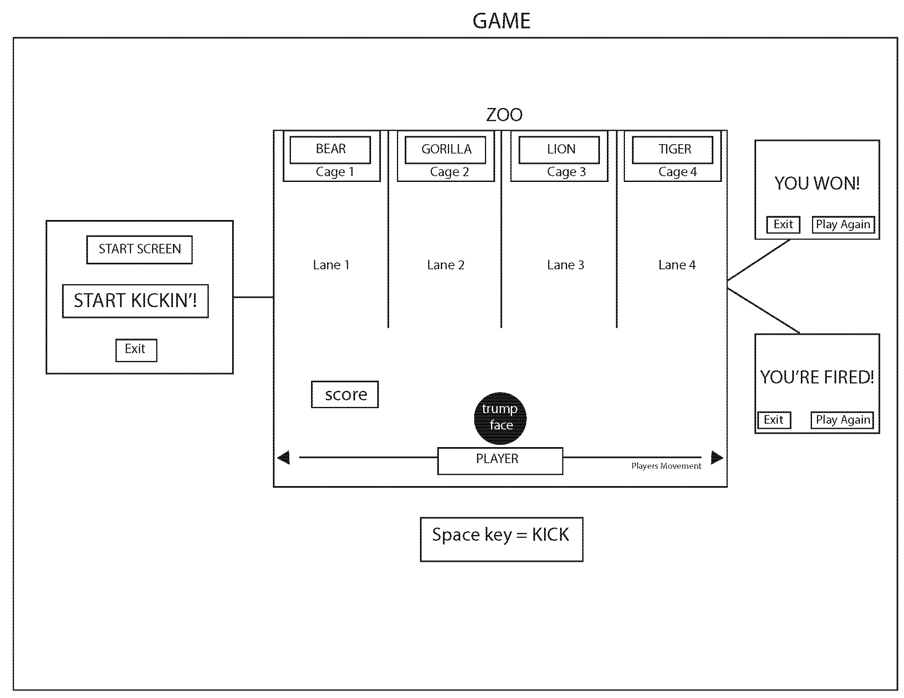
Game User Flow Diagram

Slide 7
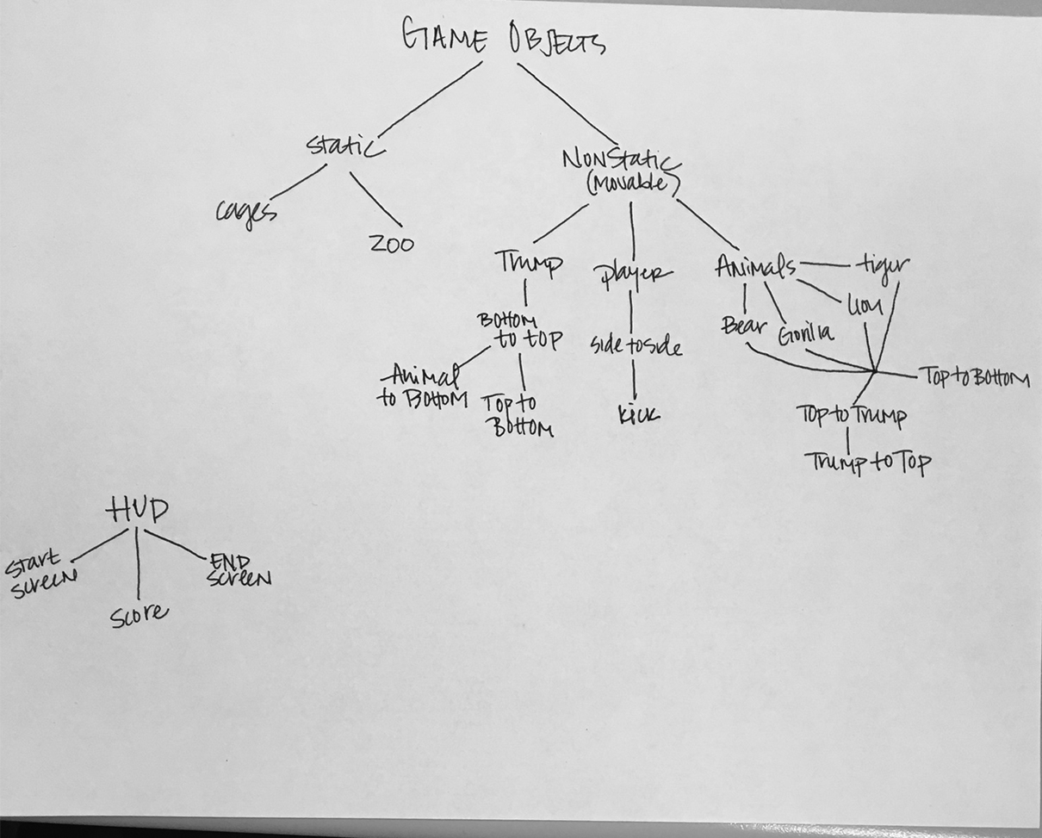
GAME INHERITANCE -ORIGINAL

Slide 8
Game Inheritance - Final
StartScreen
Js object ()
GameScreen
HUD
WonScreen
gameObj
Screen
LostScreen
Static
Dynamic
Score
Zoo
Cage
Visible
invisble
Animal
Trump
Player
Master

Slide 9
Game Compositing – GameScreen
GameScreen
Score
Zoo
Trump
Player
Cage
Animal
Cage
Animal
Cage
Cage
Animal
Animal

